Slide 1
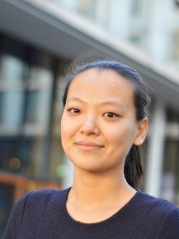
Miranda Cheng
Notes:
# Name Miranda Cheng # Textbook Theoretical Physics and Astrophysics, Ginzberg, 1st edition Knight, Physics for Scientists and Engineers: A Strategic Approach with Modern Physics, 3rd Edition, Chapter 37 # Description Miranda Cheng is a mathematician and theoretical physicist at the University of Amsterdam. She works with the theoretical concept of Umbral Moonshine, which works with the presence of shadows in the theory of mock modular forms. Her background includes dropping out of high school in Taiwan to be part of a punk rock band at the age of 16 and then later entering university as a part of a gifted program. She now works as an assistant professor at the University of Amsterdam and does work connecting to K3 surfaces and string theory. She is able to pass on excitement and knowledge to students and expand the field of theoretical physics as is related to mathematics. # Sources “Miranda Cheng.” Wikipedia, Wikimedia Foundation, 17 Feb. 2018, en.wikipedia.org/wiki/Miranda_Cheng. Amsterdam, Universiteit van. “Dr. C.N. (Miranda) Cheng.” Home - Universiteit Van Amsterdam, 13 Dec. 2017, www.uva.nl/en/profile/c/h/c.n.cheng/c.n.cheng.html. # Photo http://www.uva.nl/binaries/content/documents/personalpages/c/h/c.n.cheng/profilepicture/profilepicture/myprofile%3Aimage?1460630406407

